Slide 1

Live Webinar: Mit Lenovo & Veeam Unternehmensdaten schützen und sichern
8. Februar 2024

Slide 2
PIERRE:
Welche Vorteile gibt es mit Lenovo Storage in Bezug auf Ransomware?

Slide 4
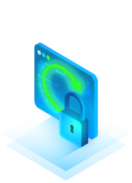
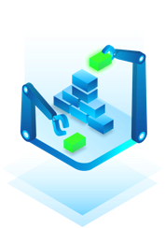
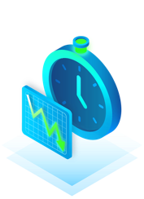


Ransomware & Cyber Attack Portfolio
Pre-Breach
Detection
Remediation
+
+
+
ONTAP Snapshot | 3-2-1-1-0
ONTAP SnapLock Compliance | Linux hardened repository
SnapMirror SnapVault | Surebackup
Lenovo Tape
ONTAP Anti-Ransomware | Veeam ONE
Restore from storage snapshot (local / remote)
Instant workload recovery
Secure restore
Datalabs / last known good
Orchestrated recovery

Slide 5
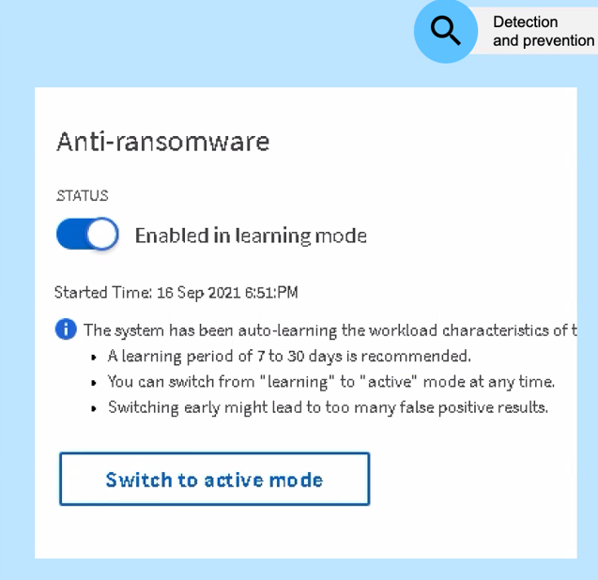

ONTAP Anti-Ransomware
On-box automatic ransomware detection
On-box ML analytics engine leverages volume file activity and data entropy
Learning mode (min. 7 days, recommended 30 days)
Alerts admin via EMS, System Manager, Unified Manager, CLI
Does not disrupt I/O; only alerts on suspected activity
Automatically takes a Snapshot
Admin can determine if it is a false positive
Additional layer of detection and ransomware protection

Slide 6
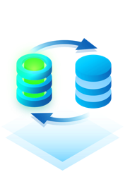
Storage Snapshots for Better Recovery Point Objective
Use Storage Snapshots between the Backups (once per hour or more frequent) for better RPO
8 PM
8 PM
8AM
9 AM
10 AM
11 AM
12 PM
1 PM
2 PM
3 PM
4 PM
5 PM
6 PM
Nightly
Backup
Snap
Snap
Snap
Snap
Snap
Snap
Snap
Snap
Snap
Snap
Snap
Nightly Backup

Slide 7
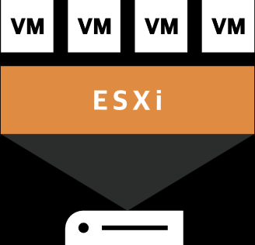





Lenovo DM Series Integration
Backup Operation Optimization
Backup from storage replica
  Leverage ONTAP SnapMirror/SnapVault
  Offload backup processing from production storage
Backups
Veeam Backup
& Replication
ThinkSystem DM Series
(primary)
ONTAP Replication
SnapMirror/SnapVault
ThinkSystem DM Series
(secondary)

Slide 8
JAN:
Welche Funktionen bietet Lenovo zusammen mit Veeam, um gesicherte Daten einfach und schnell zu testen?

Slide 10

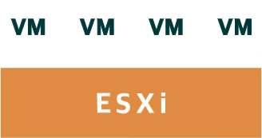
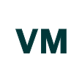
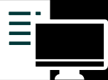




DataLabs on Storage Snapshots
On-demand DevOps
Isolated Virtual Lab
Manual testing
ThinkSystem Server
Start a copy of your production environment at any time for…
Testing
Security
Training
Troubleshooting
ThinkSystem Server & ThinkSystem DE
Lenovo ThinkSystem DM
Snapshots
Backups

Slide 11

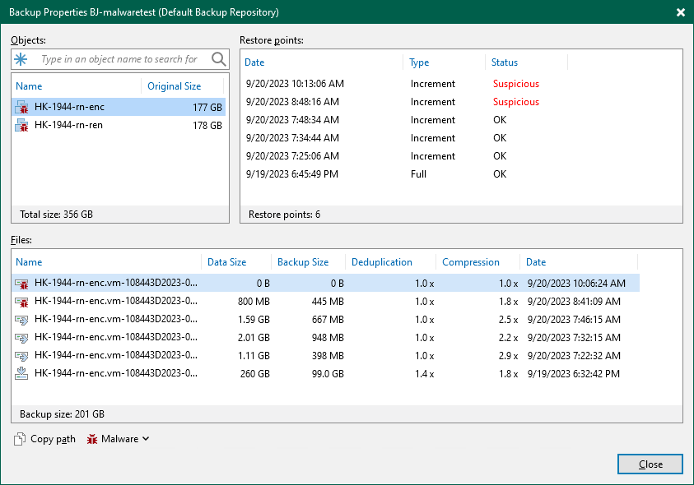







Inline Malware Detection
Architecture
Flag infected backups
Backup Server
Send metadata
Proxy
Backup data
Store data
Tue. 08.00am
Tue. 09.00pm
Wed. 08.00am
AI /ML Inline detection
Backup Repository

Slide 12
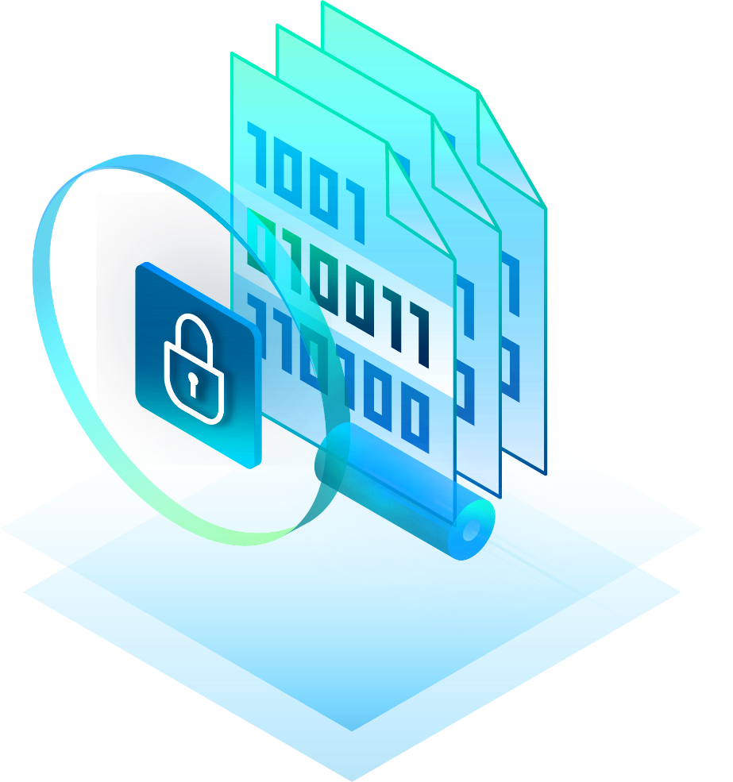
How Inline Malware Detection works
During backup
Collect metadata & statistics
Data are cross-correlated
After backup
Store malware metadata file in VBRcatalog
Compare current & previous malware metadata
What we look for?
Incremental backup size Encryption (absolute size & percent)
Compression Removed data
Newly encrypted data

Slide 13
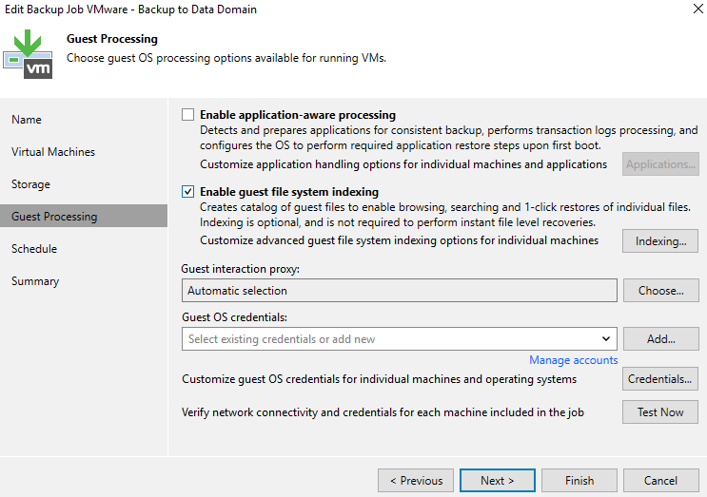
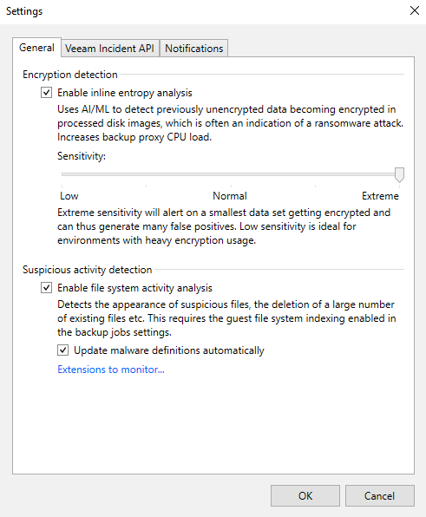
File Index scan

Slide 14

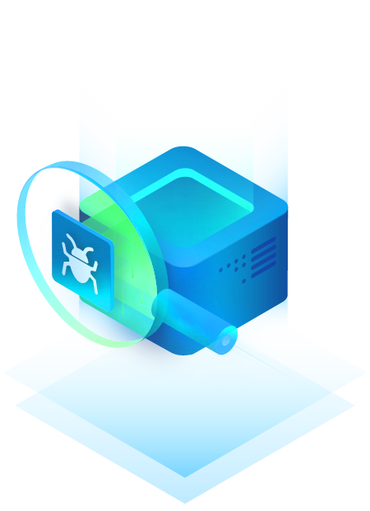
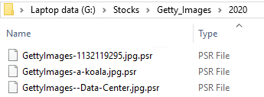
Find encrypted files and Malware binaries
With in-Guest index detection
Encrypted files usually have special file name extension
4000+ pre-defined file names extensions
Dynamic detection of unknown extensions
Find known malware binary names
  E.g., Petwrap.exe

Slide 15
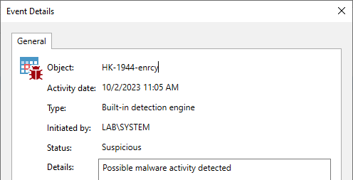
Inline Malware Detection
Malware event

Slide 16
JAN:
Wenn trotz aller Vorsichtsmassnahmen eine Infektion durch Ransomware auftritt, welche Features für die Wiederherstellung bietet Veeam an?

Slide 18
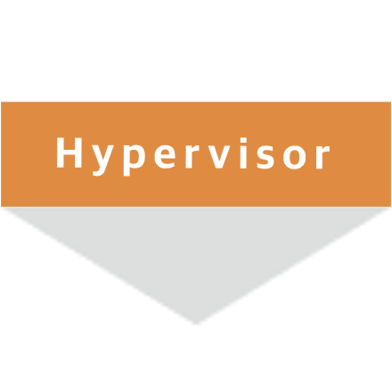
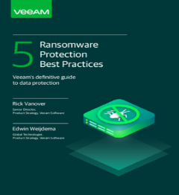
Ransomware Risk Mitigation with Orchestrated Snapshots
Ransomware Application
Snapshots can be scheduled through Veeam
as often as every 15 minutes
Frequent and secure restore points
Other Considerations
Secure the ThinkSystem DM array
Secure the Veeam backup infrastructure
Reference Veeam Whitepaper 5 Ransomware Best Practices for ransomware education and tips to secure Veeam backup infrastructure
https://www.veeam.com/wp-protection-yourself-from-ransomware.html
Lenovo ThinkSystem DM
Orchestrated Snapshots

Slide 19







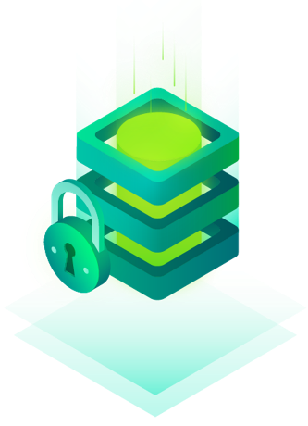
Lenovo + Veeam First Tier Immutable Backups
Database, Applications, Files & Data
Lenovo ThinkSystem Server + ThinkSystem DE
Ransomware Application
Hardened Linux Repository
Dedicated repository role to ThinkSystem Server
Lenovo ThinkSystem DM
Orchestrated Snapshots

Slide 20
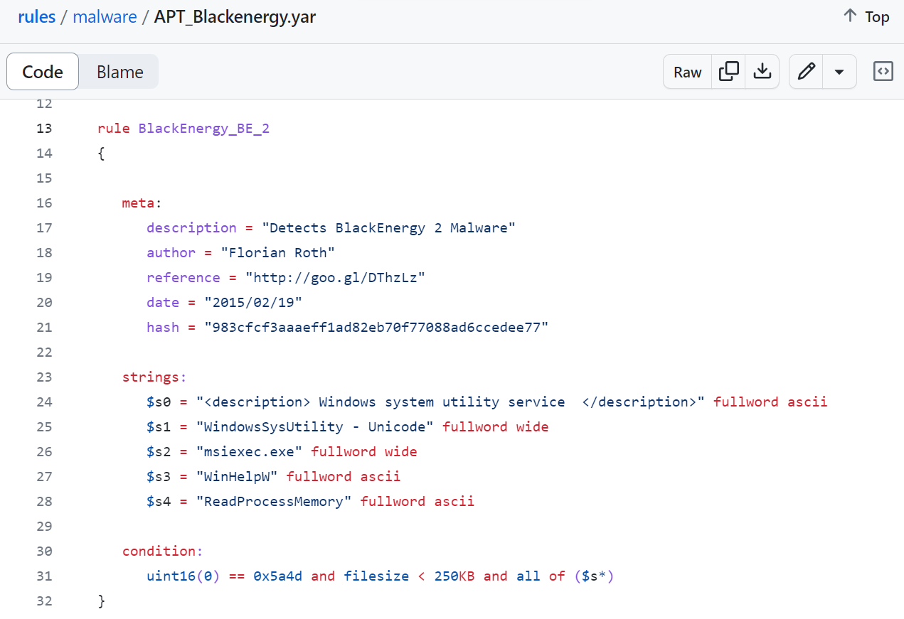
YARA?
https://github.com/Yara-Rules/rules/blob/master/malware/APT_Blackenergy.yar
Signature based detection
  Yes / no result
  Anyone can write rules
  Not a silver bullet
Can be used to find “anything” e.g. credit card numbers
smaller 250KB
Windows binary
All $s conditions

Slide 21
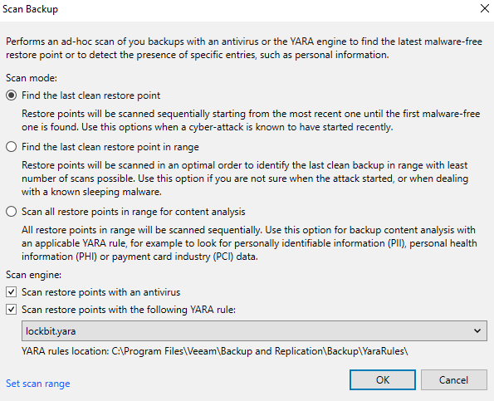





YARA Threat Detection Engine
YARA is used in digital forensics and incident response
Ad-hoc Yara scan for a specific backup
Integrated into Surebackup and secure restore
Can be used daily or during incident response
Malicious Things
Clean Backup
Encryption
Access
Forensic Analysis identified malware strain
Threat Actor
Inline Ransomware Scanner
detected encryption event
Day 1
Day 7
Day 8?
Day 9
YARA scanner identified infected restore points
Accelerates clean recovery from ransomware while reducing the chance of reinfection

Slide 22
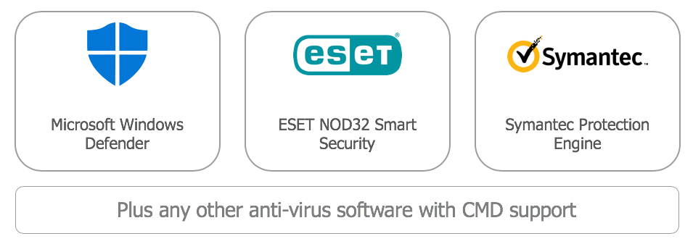

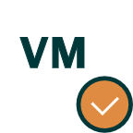
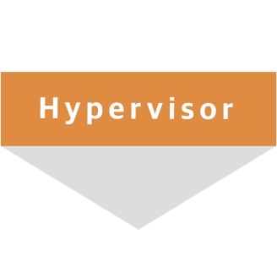



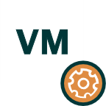

Secure Restore
3. anti-virus check
4a. No infections found; continue to restore
1. Select restore point
Veeam mount service
Anti-virus software
Backup
repository
4b. Infection found;
proceed recovery but disable network
2. Mount disks directly from the backup file to the mount server
Anti-virus software with identified IOC signatures
4c. Infection found; stop restore

Slide 23
JAN:
Sind meine Daten in M365 nicht bereits durch Microsoft geschützt und ein Backup somit überflüssig?

Slide 25
The 365 Shared Responsibility Model
Primary
Responsibility
Supporting Technology
Security
Regulatory
MICROSOFT GLOBAL INFRASTRUCTURE
Uptime of the
Microsoft 365
Cloud Service
365 Data Replication
DC to DC geo-redundancy
Infrastructure- Level
Physical Security
Logical Security
App-level Security
User/Admin Controls
Role as data processor
Data Privacy
Regulatory Controls
Industry certifications
HIPPA, Sarbanes-Oxley
Microsoft’s Responsibility
Learn more from
the 365 Trust Center
Recycle Bin
Limited, short term data loss
recovery (no point-in time recovery)
Data-Level
Internal:
Accidental Deletion
Malicious Insiders
Employee Retaliation
Evidence Tampering
External:
Ransomware
Malware
Hackers
Rogue Apps
Role as data owner
Answer to corporate and industry regulations
Demands from internal legal and compliance officers
Your
365 data
Access and control
of your data residing
in 365
365 Backup
Copy of your data
stored in a different location
YOUR Responsibility
Full Data Retention
ST & LT retention filling any/all policy gaps granular &
point-in time recovery options

Slide 26







There are 7 reasons WHY you need Microsoft 365 backup
Accidental
deletion
Retention policy confusion/gaps
Internal security threats
Malicious insiders/departing employees
External security threats
Ransomware/
rogue apps
Legal
and compliance requirements
Managing hybrid deployments
and migrations
Teams
data structure
Read the Special Report on the 7 Reasons at:
https://go.veeam.com/wp-why-backup-office-365-data

Slide 27


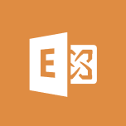
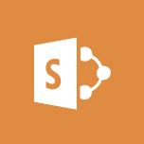

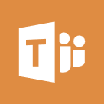








Veeam Backup for Microsoft 365
Backup from on-premises and Microsoft 365 services
to local or object storage
Microsoft 365
Veeam Repository
Backup
Data
DE Series
Exchange
Online
SharePoint
Online
OneDrive
for Business
Microsoft
Teams
Object storage
Meta Data &
Backup Data
Amazon S3
S3-compatible
On-premises
Veeam Backup
for Microsoft 365
Backup
Data
RAM
Microsoft
Azure Blob
IBM
Cloud
Exchange
SharePoint
Meta Data
Cache Repo
Local storage
PowerShell
RESTful API

Slide 28





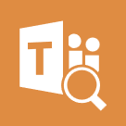
Veeam Backup for Microsoft 365
Delivering flexible restore options
Recovery Tools
Microsoft 365
Veeam Explorer™
for Microsoft
Exchange
Veeam Repository
Browse, Search & Restore Data
Exchange
Online
SharePoint
Online
OneDrive
for Business
Microsoft
Teams
Additional Recovery Options
DE Series
Veeam Explorer
for Microsoft
SharePoint
Object storage
Restore prior version
Save as a file
On-premises
Amazon S3
S3-compatible
Email as
an attachment
.pst
Veeam Explorer
for Microsoft
OneDrive
Export to .pst
or .zip
Restore Data
Microsoft
Azure Blob
IBM
Cloud
Exchange
SharePoint
Service Provider restore for a tenant
Veeam Explorer
for Microsoft
Teams
Cache Repo
Browse / Search
Local storage
RESTful API

Slide 29
JAN:
Kann ich die Lösungen von Veeam auch einfach als Service beziehen?

Slide 31
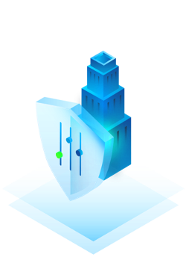
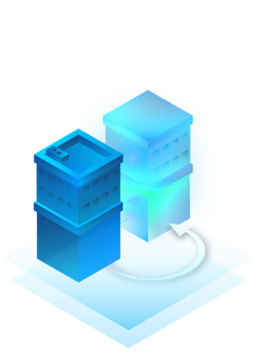

Veeam Cloud Service Provider Options
Service Provider
Data Protection
Offsite Backup
Public Cloud
Data Protection
Managed Backup
DRaaS
SaaS Data Protection
Universal services: Migration, automation and APIs
Replication
expedite seeding
Native Integrations
automate service delivery
Universal APIs
simplify customization
Mobility Features
offer portability across clouds
© 2019 Veeam Software. Confidential information. All rights reserved. All trademarks are the property of their respective owners.
Notes:
These are the top VCSP use cases
Many of our VCSPs provide three services in the upper left corner
Many times we start with a service provider to backup their private cloud, as the most reliable and capable provider
VCSPs often expand services to provide different variations of managed and offsite backup using our innovative cloud connect capabilities
What we are seeing is service provider expansion in VB365 backup, public cloud data protection and DRaaS
And we see innovation through the leveraging of Service Provider Console and APIs to provide automation and service features to enhance offerings.

Slide 32

Veeam Cloud Connect
Fast, secure cloud-based backup and replication
Master the 3-2-1-1-0 Rule without investing money and resources into a second site or adding bandwidth. Veeam® Cloud Connect offers fast and secure backup and recovery for data centers, endpoints and the cloud, all from a single web-based console.
Natively Integrated | Securely designed | Execute a hybrid strategy
Easily send backup and replica jobs offsite to a service provider in just a few clicks. No additional licensing requirements for Veeam Data Platform customers | End-to-end encryption protects data at the source and in-flight through a secure SSL/TLS connection and at rest. Protect backup data from intentional or accidental deletion with insider protection services | Easily store backups off-site for retention, secure recovery and more by leveraging a service provider’s cloud. Get started quickly without the need to build out additional backup infrastructure. Achieve full- or partial-site failover to a remote disaster recovery (DR) site from any location through a secure web portal. (incl. CDP)
Notes:
The focus here should be on clean recovery at scale. Questions can be asked about moving beyond granular item recovery and what the customer will do in the event of a mass recovery scenario.

Slide 33


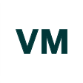


Off-site Backup
Take advantage of flexible Off-site Backup capabilities from Veeam®, including cloud and traditional options that execute the 3-2-1 rule for you.
Hyper-V or VMware-hosted, multi-tenant cloud
Customer Environment
Veeam Cloud Connect repository
Veeam Service Provider Console
Scaled to object storage
Protected with Veeam
S3-(compatible) Object Storage /
Azure Blob
Managed Cloud
Veeam Backup
& Replication™
1
2
Multi-tenant
off-site backups
Single-tenant
off-site backups
Virtual servers
Physical servers
Web-based customer onboarding, billing and licensing
Public Cloudservers
Workstations
Secure, self-service
customer access
Notes:
Off-site Backup allows us to help with data survivability – getting a copy of your data off-site. With Veeam’s technology, we can easily restore that data whether it’s a single file, virtual machine or the whole site. We do this with a product called Veeam Cloud Connect. It’s included in Veeam Backup & Replication and is simple for you to activate with a few clicks. Where we store that data is up to you – it can go into a public cloud like Azure or AWS or in our datacenter.
No need to invest in a second site for your backups
Rent a dedicated cloud repository from a service provider
Encrypt and send data through a secure SSL connection
No VPN needed
Maintain complete visibility and control:
Recover data quickly from hosted backup repositories
Access backup data directly from within the backup console
It’s fully integrated!
Leveraging Backup Copy jobs, Built-in WAN Acceleration, forever incremental backups and more

Slide 34


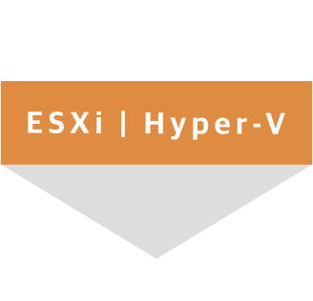
Disaster Recovery as a Service (DRaaS)
Veeam provides the connection between customers and providers to make executing
full- or partial-site failover an affordable and effective reality.
VMware Cloud Director
Customer Environment
Veeam Cloud Connect
Hyper-V or VMware-hosted, multi-tenant cloud
Protected with Veeam
Your managed cloud
*Note: Replication
is not available for
Agent-protected Physical Servers and Workstations
Off-site backups
and replicas*
Veeam Backup
& Replication™
Web-based customer onboarding,
billing and licensing
Virtual Machines
Physical servers
Secure, self-service
customer access
Workstations
DR planning and executable failover/failback
Notes:
Disaster Recovery as a Service is an outsourced service that is also powered by Veeam Cloud Connect. With this offering, we can execute failover and failback within your established RTOs and RPOs to minimize downtime should an unplanned event occur. Access to Veeam Service Provider Console

Slide 35
PIERRE:
Gibt es von Lenovo Cloud oder Backup as a Service Lösungen?

Slide 37

Lenovo TruScale with Veeam Data Platform
Combining Lenovo ThinkSystem portfolio
with Veeam Data Platform,
our solution is designed to help you:
Reduce recovery time
Enjoy a cloud-like experience - on-premises
Simplify IT complexity
Maintain data sovereignty

Slide 38
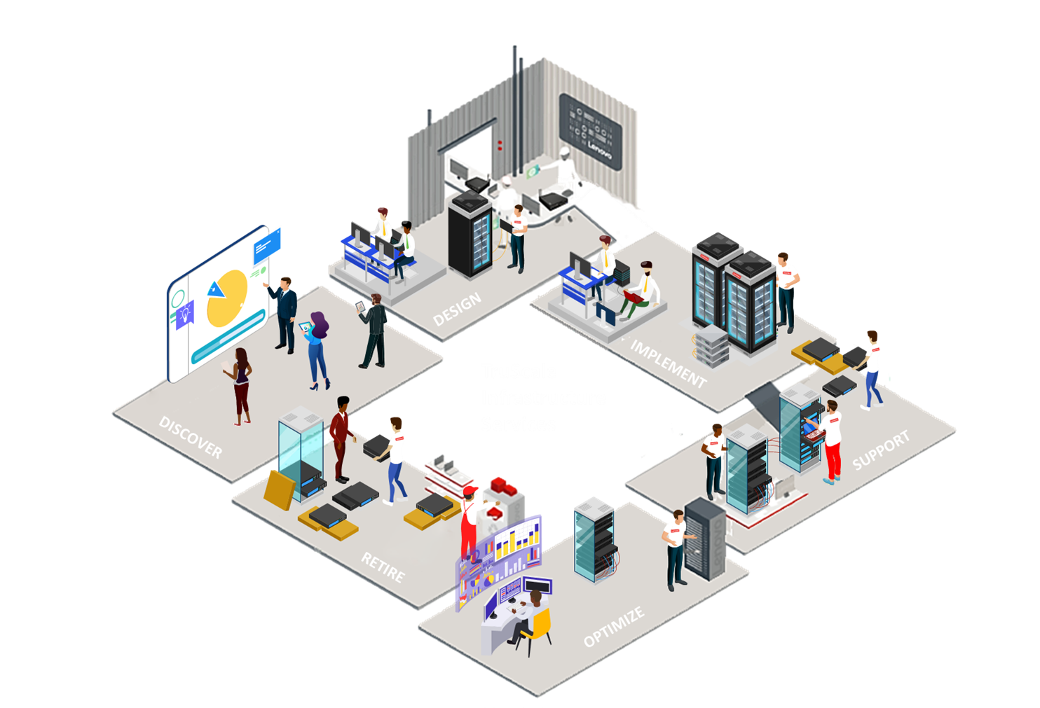

TruScale - An Innovative Approach
2
DESIGN
Solution Architecture
Capacity Planning
Best Recipe Development
Technology Areas
Hybrid Cloud
  Data & Analytics
  HPC & Data Center Cooling
  Virtualization & VDI
3
IMPLEMENT
Hardware Installation
Migration
Deployment
4
SUPPORT
Warranty Upgrade/Extension​
Premier​ Support
Customer Success Manager
Enterprise Server Software​
Your Drive Your Data
1
DISCOVER
Workshop
Assessment
6
RETIRE
Hardware Deinstallation
Asset Recovery
  Recycling/Disposal
  Data Sanitization
  Drive Destruction
5
OPTIMIZE
Managed Services​
Firmware/Best Recipe Update​​
Preventative Maintenance
Health Check ​

Slide 39
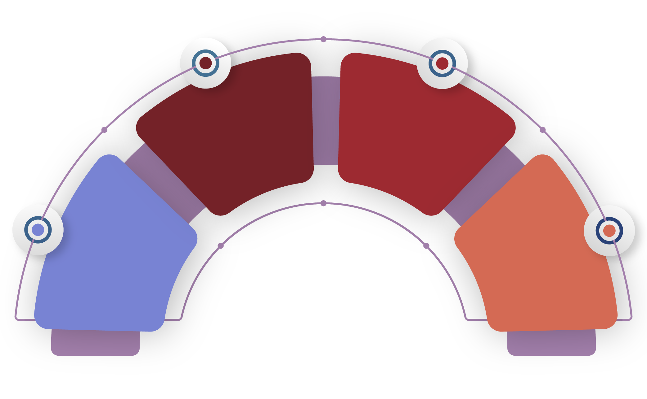


TruScale is a framework for Lenovo Everything as a Service
Industry’s broadest portfolio
from pocket to cloud delivered as a service.
Infrastructure
aaS
Single unified framework
to easily manage day-to-day IT operations with full visibility and accountability.
Device aaS
Global scale capability
to rapidly and securely provision global teams – anytime, anywhere.
Software aaS
IoT aaS
Flexible consumption models
fixed or metered pay-as-you-go model that frees-up capital with minimal up-front costs.

Slide 40
PIERRE:
Wie geht der Kunden in einen Supportfall vor? Zwei Hersteller, zwei Ansprechpartner?

Slide 42









Key features of Premier Support
Direct Technician-to- Technician Access
3rd Party Collaborative Software Support
Premier Support Engineer
Comprehensive Hardware + Software Troubleshooting
Premier Support
Service
Dedicated Premier Phone Number
Response Time Options for Onsite Parts and Labor
End-to-End Case Management
Live Chat

Slide 43
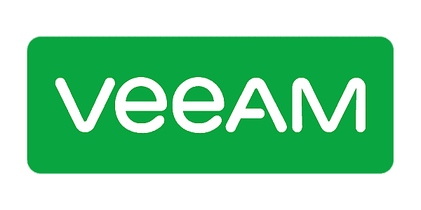


Going Beyond Traditional Break/Fix
Comprehensive Hardware & Software Problem Determination
Premier Support Engineers:​
​
Provide remote support from call receipt to call closure​
Perform hardware and software triaging to isolate the issue ​
Collaborate with software vendors on your behalf to open and resolve cases​
Remain engaged from case creation until closure for consistent end-to-end support experience
Hardware Issue
Part Dispatch
Premier Support Engineer
Lenovo L3
Escalation
Customer
Software Issue
Lenovo Software Issue Resolution

Slide 45


Wünschen Sie eine persönliche Beratung?
Simon Häni
Head of System Integration
Member of the Management
simon.haeni@cancom.com
+41 58 400 00 78
Digitale Visitenkarte

